Slide 1
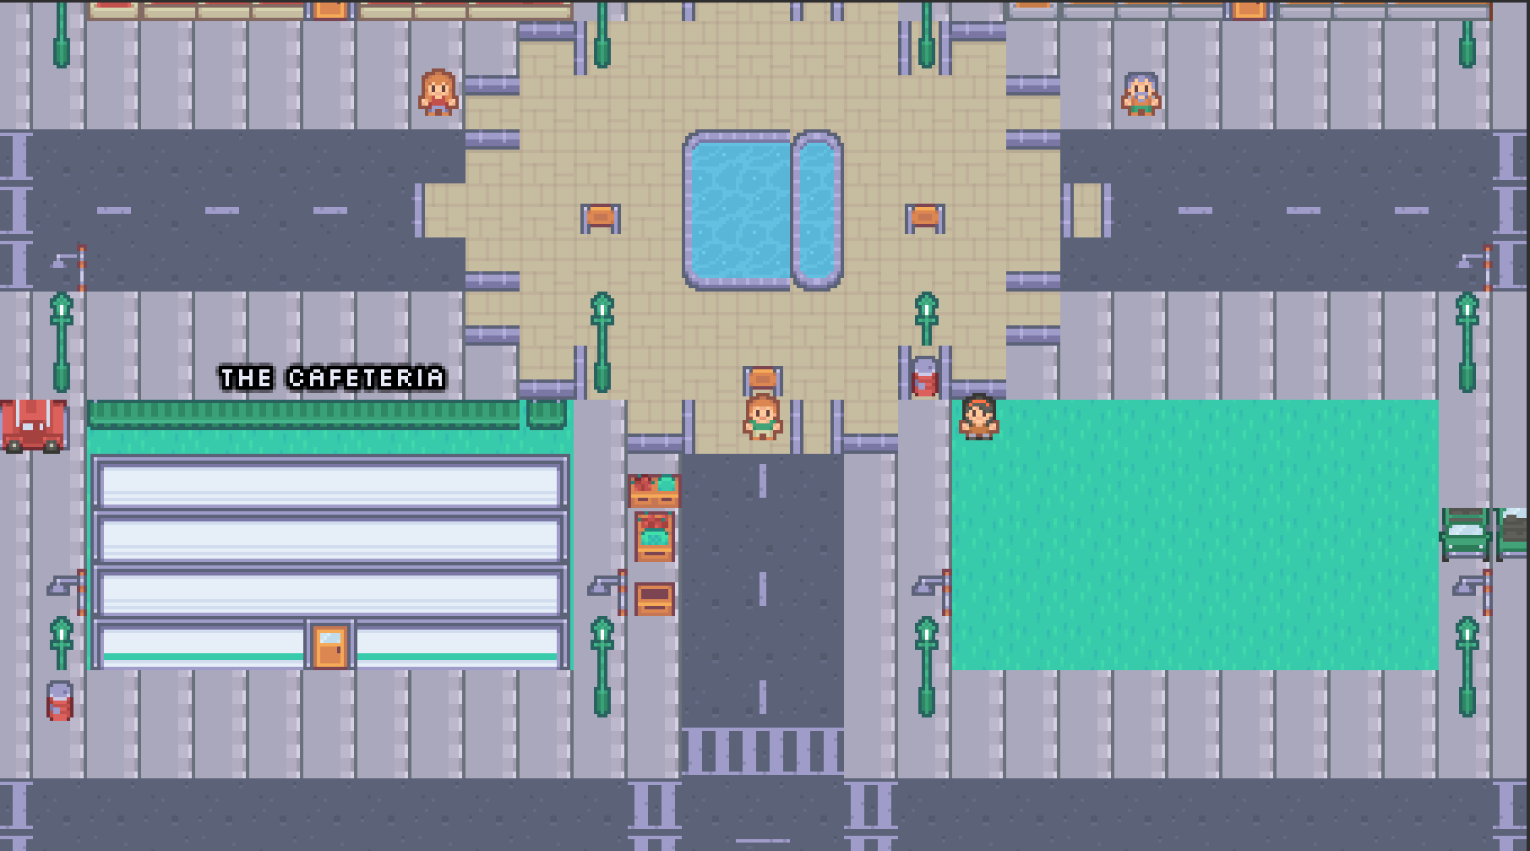
NOVUS
BUILD 0.1
Finance, played.
A browser RPG where you take a desk at a bank, judge loan files against real numbers, trade a market that ticks — and live with every call you make.
CREDIT DECISIONS
LIVE MARKET SIM
TRANSCRIPT AND ACADEMY
Notes:
Novus is a fintech RPG that teaches financial decision-making by simulation. Plays in the browser, single player, Indian setting.

Slide 2
01
THE PROBLEM
26 cr
FINANCIALLY LITERATE ADULTS
27%
trading accounts on the NSE, June 2026
The last crore was added in under four months. Demat accounts stand at 23.4 crore.
33% urban, 24% rural. NCFE Financial Literacy and Inclusion Survey, 2019.
The missing piece isn't information. It's practice — nobody feels the cost of a bad allocation until they make one with their own money.
Notes:
Access to markets has scaled faster than competence: 26 crore trading accounts against a literacy rate of 27%.

Slide 3
02
WHY SIMULATORS
Nobody learns to fly by reading about flying.
FINANCE TEACHING
PILOT TRAINING
Lectures, textbooks, static cases, quizzes with a progress bar.
Computer-based training, then the simulator, then the aircraft.
You recognise the vocabulary, never commit to a call, and nothing you get wrong costs you a rupee.
The simulator's value is consequence without risk: the engine fails, you respond, and the debrief points at what the instruments were already showing.
Institutional trading simulators do exist — priced far past any student.
Medicine followed. Finance, outside the trading floor, largely hasn't.
Novus is that simulator, priced at a browser tab.
Notes:
Aviation solved this with CBT and simulators; medicine followed with mannequins and OSCEs. Finance still teaches by reading, unless you can afford an institutional trading sim.

Slide 4
03
THE TEACHING MODEL
Consequence first. Vocabulary second.
The bad call plays out and costs you. Then — and only then — the game explains what it turned on.
No concept card ever interrupts a decision. Teaching arrives after the outcome, pointing at numbers already on screen.
Reasoning is graded against a hidden truth, never the dice. A sound call that still defaulted stays sound.
Notes:
This is the teaching model, and the one rule the game will not bend: the bad decision plays out and costs you, and only then is it explained.

Slide 5
04
THE WORLD
A city that runs on money.
WALKABLE
TIMED
POPULATED
Eight enterable venues — bank, exchange, fintech floor, academy, risk, payments, café, home — and scenery in between.
A day runs 9:15 to 3:30 at one real second per game minute. Time is the pressure, not an energy bar.
NPCs give advice that is confident and often wrong. Whose word is worth anything is something you work out.
Notes:
One walkable pixel city, eight enterable venues, a day that runs 9:15 to 3:30 at one real second per game minute.

Slide 6

05
A DAY IN NOVUS
One strip, the whole state.
9:15 → 3:30
CASH
ENERGY
CASH · DAY ARC · CLOCK
Stored as whole paise, shown in lakh and crore through one formatter — never by hand.
Bars fill in blocky steps. There is no health bar, because nothing here is combat.
REPUTATION
THE DAY ARC
Earned by sound calls, spent when you push a file through on a hunch.
A pixel sun crosses the trading day, so "half the day is gone" is something you see.
₹5,00,000 of the bank's money, the sun a third of the way across the trading day, and 9:06 on the clock — the three things every decision is weighed against.
Notes:
The HUD is the whole state of the player in one strip: XP, energy, reputation, cash, the day arc with a pixel sun crossing it.

Slide 7
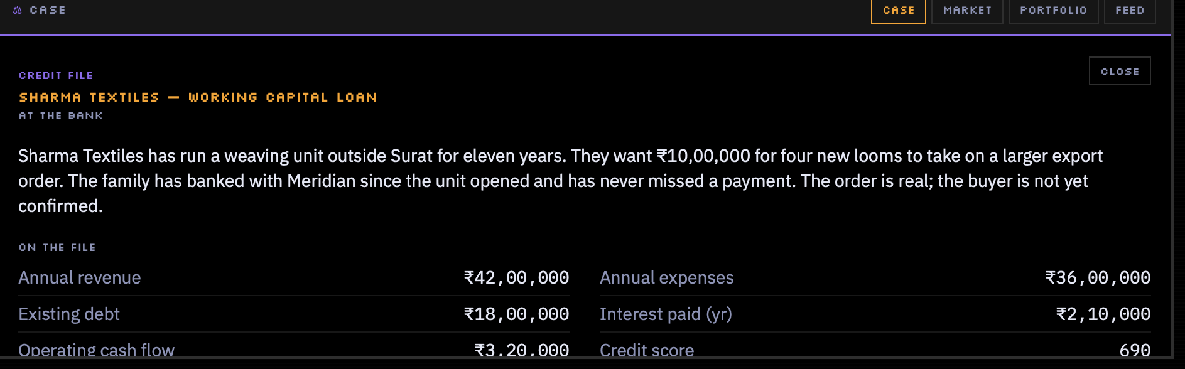
06
AT THE BANK
A weaving unit outside Surat, eleven years of history, never a missed payment. The export order is real; the buyer is not yet confirmed.
₹10,00,000 for four looms.
Every figure is real arithmetic. The debt-service cover is the whole decision.
Turn the assist off and the ratios are yours to work out — or unlock them with skills.
Approve, decline, or ask for collateral. The file is graded on why, not on what happened.
Notes:
Loan files with real figures. You make the call; it is scored on your reasoning, and afterwards the ratios are rebuilt and explained.

Slide 8
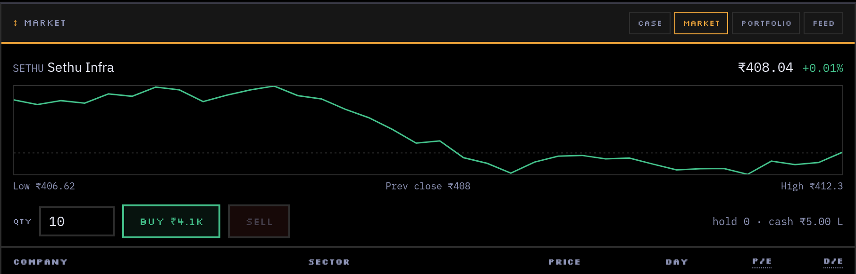
07
AT THE EXCHANGE
A market that ticks while you think.
Twelve invented companies across real sectors. Prices move every game minute: drift, noise, and the day's shock.
SEEDED
SHOCKED
FICTIONAL
A save resumes bit-for-bit, so the same day can be replayed and compared.
A rate hike, infrastructure news, a fraud headline — each lifts some sectors and leaves the rest to noise.
Nothing tradable is a real ticker. A learning game with real tickers is advice.
Notes:
Twelve invented listed companies, prices moving each game minute by drift plus noise plus sector shocks, seeded so a save resumes bit for bit.

Slide 9
08
THE EDUCATION LAYER
Six pieces, none of them a quiz wall.
THE LEDGER
PREDICT, THEN REVEAL
DAY-END DEBRIEF
Twelve concept cards — debt-service cover, cash vs. profit, leverage, drift and shock — unlocked when you meet them.
Your read is graded against the truth and echoed back on the outcome screen. Recall, not recognition.
One teaching sentence about the day, plus a mistake log that names repeated patterns: churn, a concentrated book, unsound calls.
ACADEMY MODULES
THE CASEBOOK
SCENARIO DRILLS
Five mini-courses with a short check at the end. 60% to pass, retakeable, blocks nothing.
Six concluded real events — Satyam, IL&FS, the PNB letters of undertaking, 1992, Kingfisher, 2008 — as study material with sources.
Three exercises with no city, clock or save: five files back to back, build a book, spot the shock.
All six are built and deployed — and none of them interrupt a decision.
Notes:
Six pieces make it an education tool rather than a game with finance skinned on. All six are built and deployed, and none interrupt a decision.

Slide 10
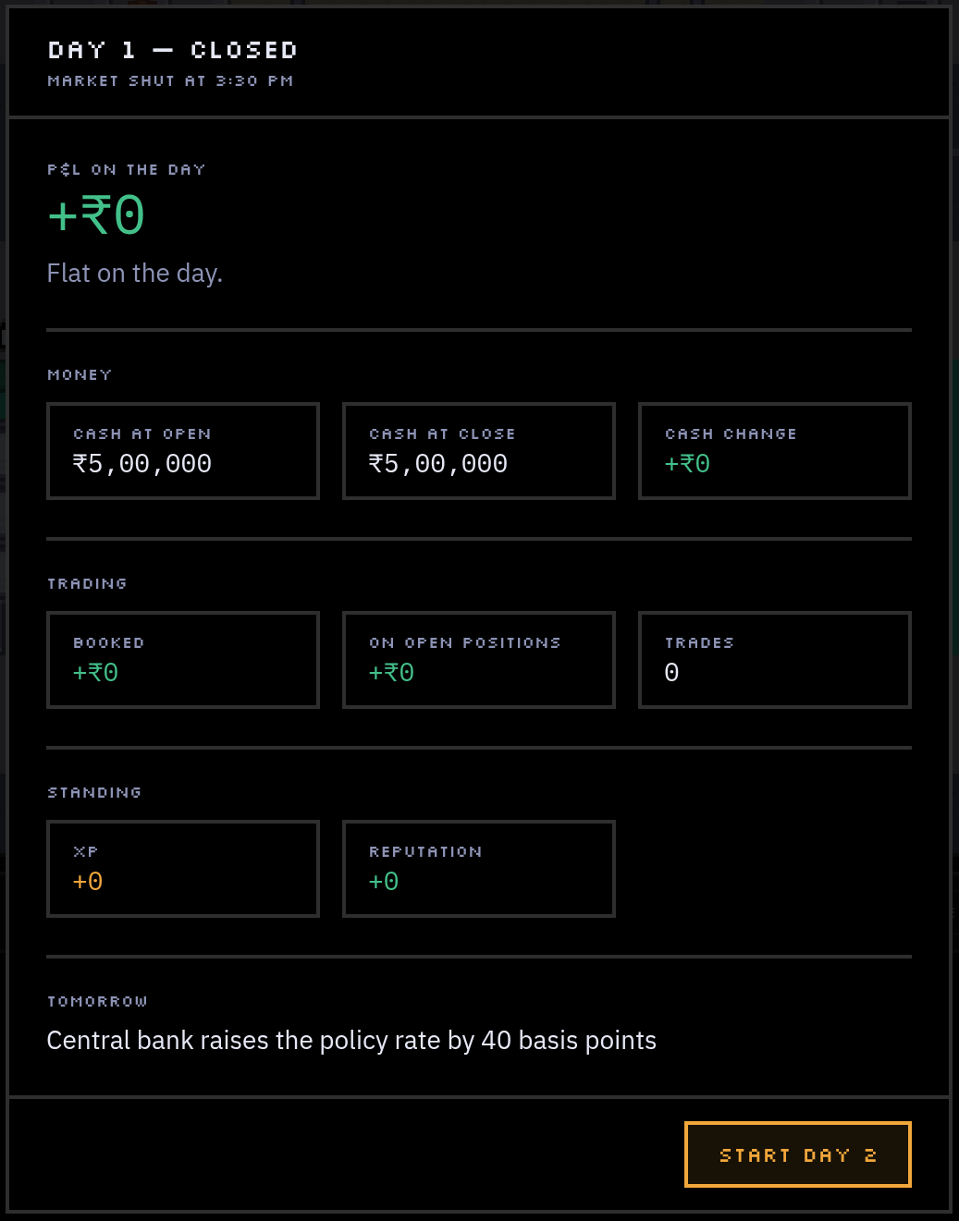
09
ASSESSMENT
A transcript, not a high score.
Every day closes with a debrief, and everything it records lands in one running record:
concepts met and understood
credit record + risk-read accuracy
best call · worst call
modules passed · mistakes logged
Copyable as plain text. A cohort view exists for classroom use, and certificates are issued off the transcript — never off cash earned.
Notes:
This is what an instructor or a recruiter reads: everything decided, predicted and got wrong, copyable as plain text. Certificates come off the transcript, never off cash earned.

Slide 11
10
UNDER THE HOOD
Three layers, kept apart.
sim/
All rules, money and randomness. Plain deterministic TypeScript.
May never import React or Phaser, or call Math.random — seeded RNG only.
world/
Phaser draws the city and moves the player.
Decides nothing about money, and reaches the app through one bridge file.
ui/
React shows state and sends actions. No arithmetic of its own.
Everything meets at one store — which is what leaves multiplayer possible later.
Vite · React 19 · TypeScript (strict) · Tailwind v4 · Phaser 4 · Zustand · Supabase (optional)
Art: Kenney RPG Urban (CC0). The optional AI layer rephrases case wording only — never a number, a grade or a lesson, and every path has written fallback text.
Notes:
Three layers kept strictly apart: sim owns money and randomness, world draws the city, ui shows state. That separation keeps the market testable and leaves multiplayer possible.

Slide 12
11
ROADMAP
One city finished, not five started.
SHIPPED
now
NEXT
in progress
THEN
designed
LATER
architected for
The city, the market, credit cases, the education layer and cloud save. Sixteen build steps and a redesign pass, deployed.
Cases beyond loan files, the three unbuilt interiors, and a source pass before the Casebook counts as final.
Careers past the intern stage — trader, banker, risk, CFO — and a cohort mode for classroom pilots.
Multiplayer over sockets, a mobile layout, options and futures. Deliberately not built yet.
Notes:
Sixteen build steps and a redesign pass are done and deployed. Next is depth: more case types, the unbuilt interiors, a source pass on the Casebook. Then careers and cohorts. Multiplayer is architected for, not built.

Slide 13
NOVUS
Play a day of it.
Take one loan call, hold a position through a rate hike, and read the debrief. Five minutes in the browser makes the argument better than this deck can.
PLAY NOW
game.akshatchowdhary.online
An educational simulation. The playable market, borrowers and events are fictional; nothing here is investment advice.
SINGLE PLAYER · PLAYS IN THE BROWSER
Notes:
Five minutes in the browser makes the argument better than any slide here. Play a day, take one loan call, read the debrief.

